Slide 1
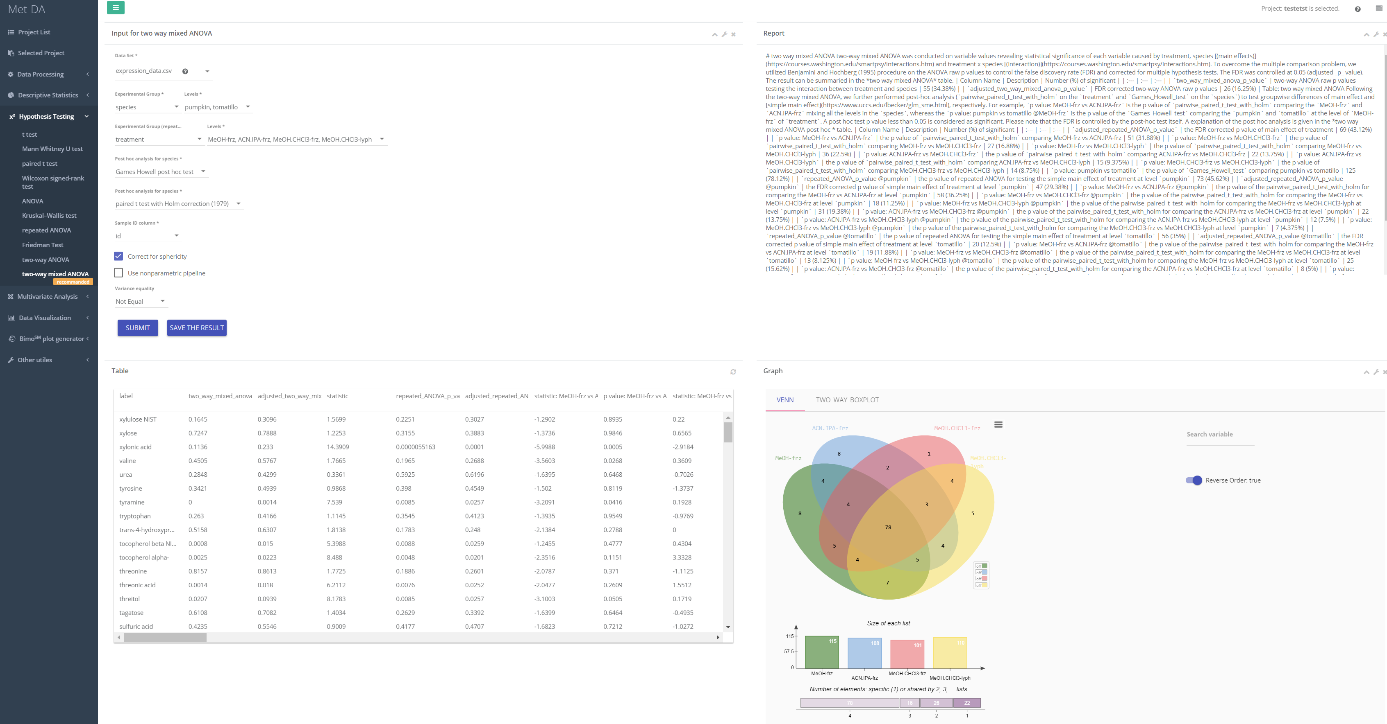
1
4
3
2

Slide 2
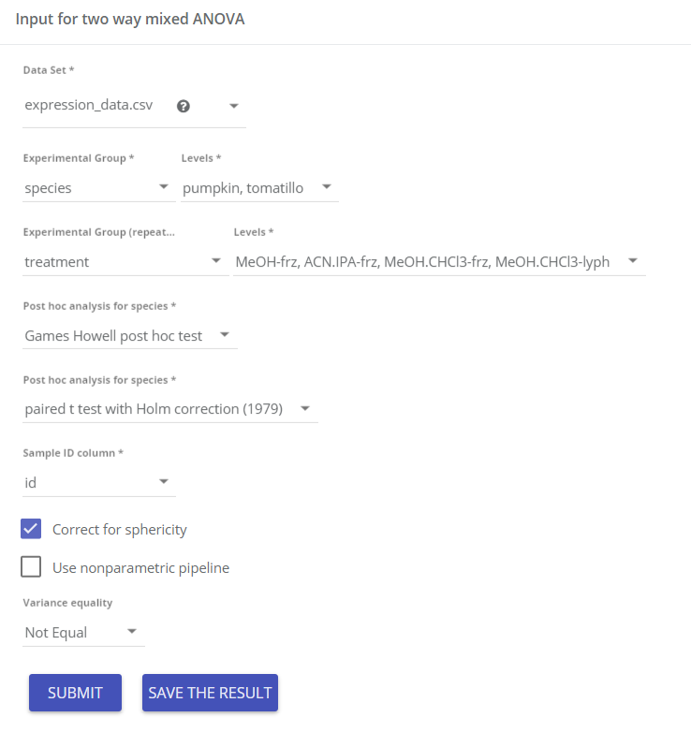
Input parameters
Data matrix for two way mixed ANOVA
Select two factors. Independent and repeated.
Choose post hoc analysis method comparing each pair of two groups in the intendent factor, e.g. pumpkin vs tomatillo
Choose post hoc analysis method comparing each pair of two groups in the repeated factor, e.g. MeOH-frz vs ACN.IPA-frz
Sample id is required for paired/repeated measure study to tell which columns of data are measured from same sample. OR how are samples paired.
Assumption of sphericity: equal variance of the differences of all the pair of two groups
Use nonparametric tests as post hoc analysis, e.g. Mann-Whitney U test and Kruskal Wallis H test
Assumption of having an equal variance among all the groups
1

Slide 3
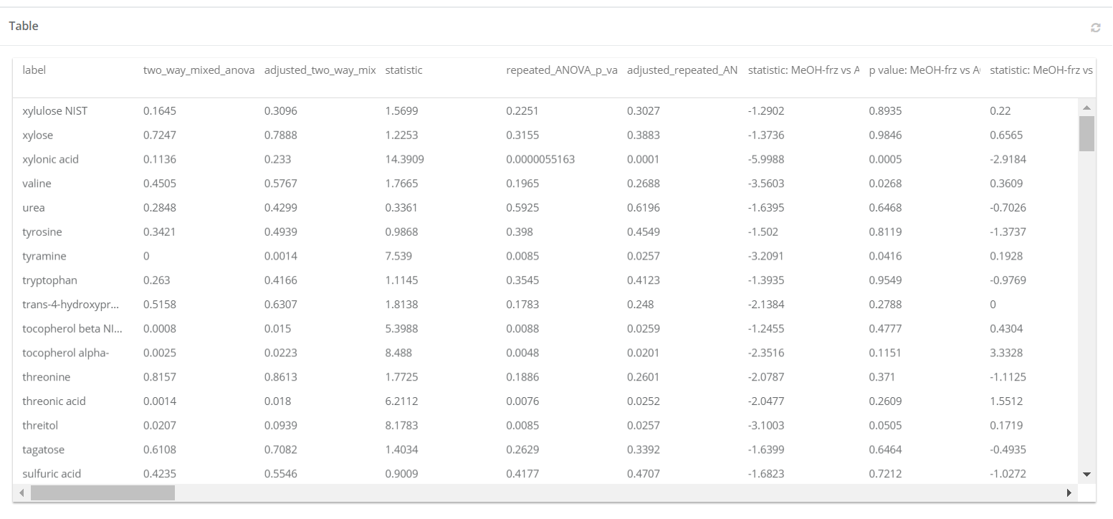
Result table
two_way_ANOVA_p_value:
P value of two way ANOVA testing for interaction between species and treatment
adjusted_two_way_ANOVA_p_value:
p value of two way ANOVA adjusted for multiple comparison problem using Benjamini-Hochberg correction.
p value: pumpkin vs tomatillo:
p value of species [main effect]
adjusted p value: pumpkin vs tomatillo:
p value of species adjusted for multiple comparison problem using Benjamini-Hochberg correction.
ANOVA_p_value:
p value of treatment [main effect]
adjusted_ANOVA_p_value:
p value of treatment adjusted for multiple comparison problem using Benjamini-Hochberg correction.
p value: MeOH-frz vs ACN.IPA-frz:
p value of post hoc analysis of MeOH-frz vs CAN.IPA-frz [main effect]
2
ANOVA_p_value @pumpkin:
p value of treatment using only the pumpkin data [simple main effect]
p value: MeOH-frz vs ACN.IPA-frz @pumpkin:
p value of post hoc analysis of MeOH-frz vs CAN.IPA-frz using only the pumpkin data [simple main effect]

Slide 4
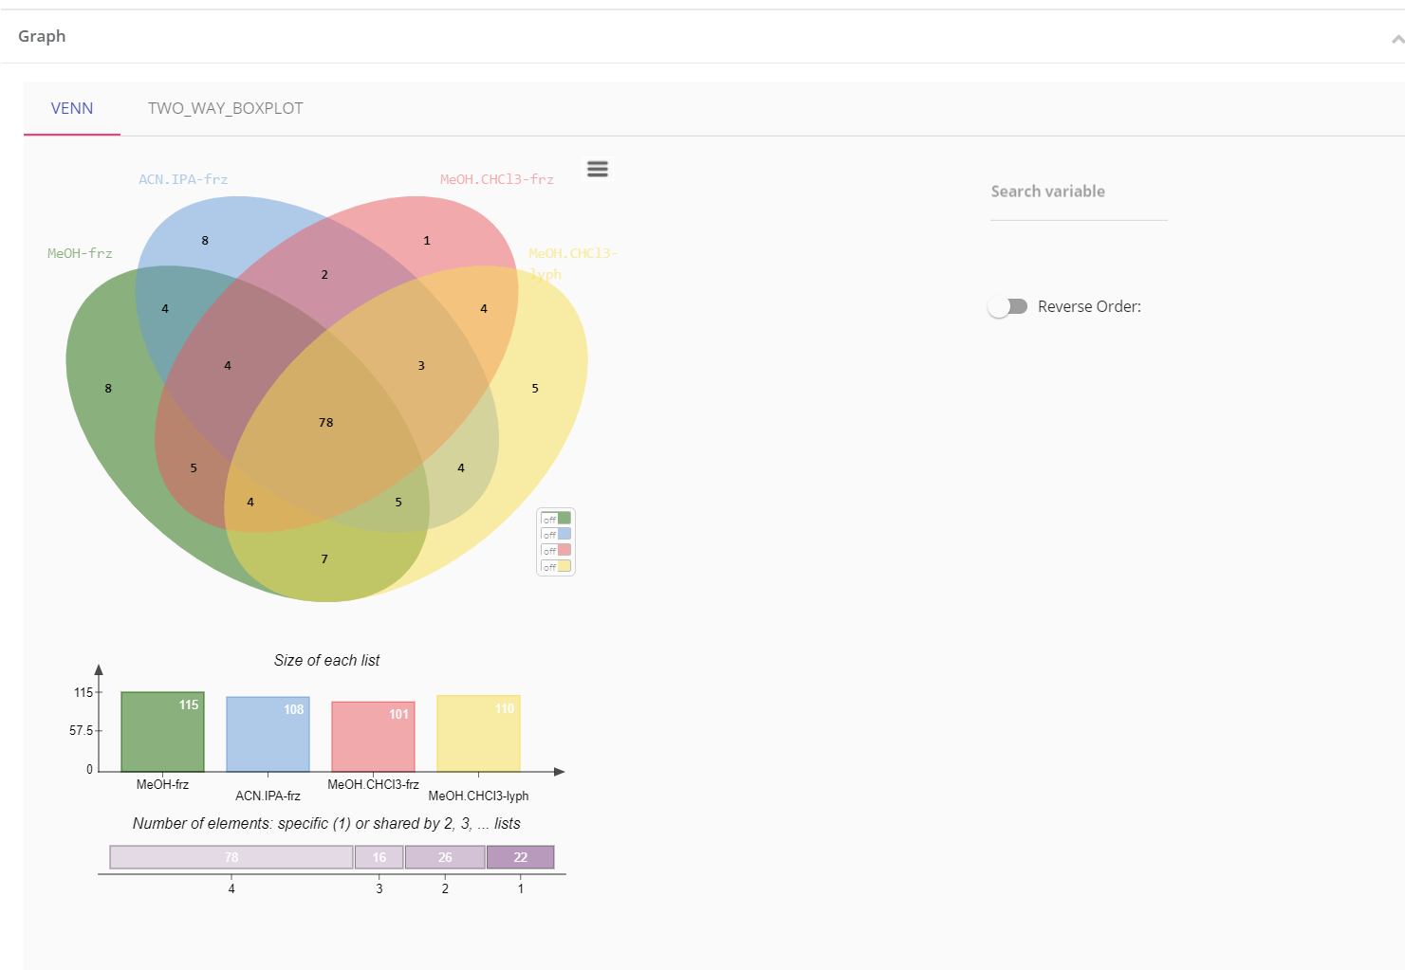
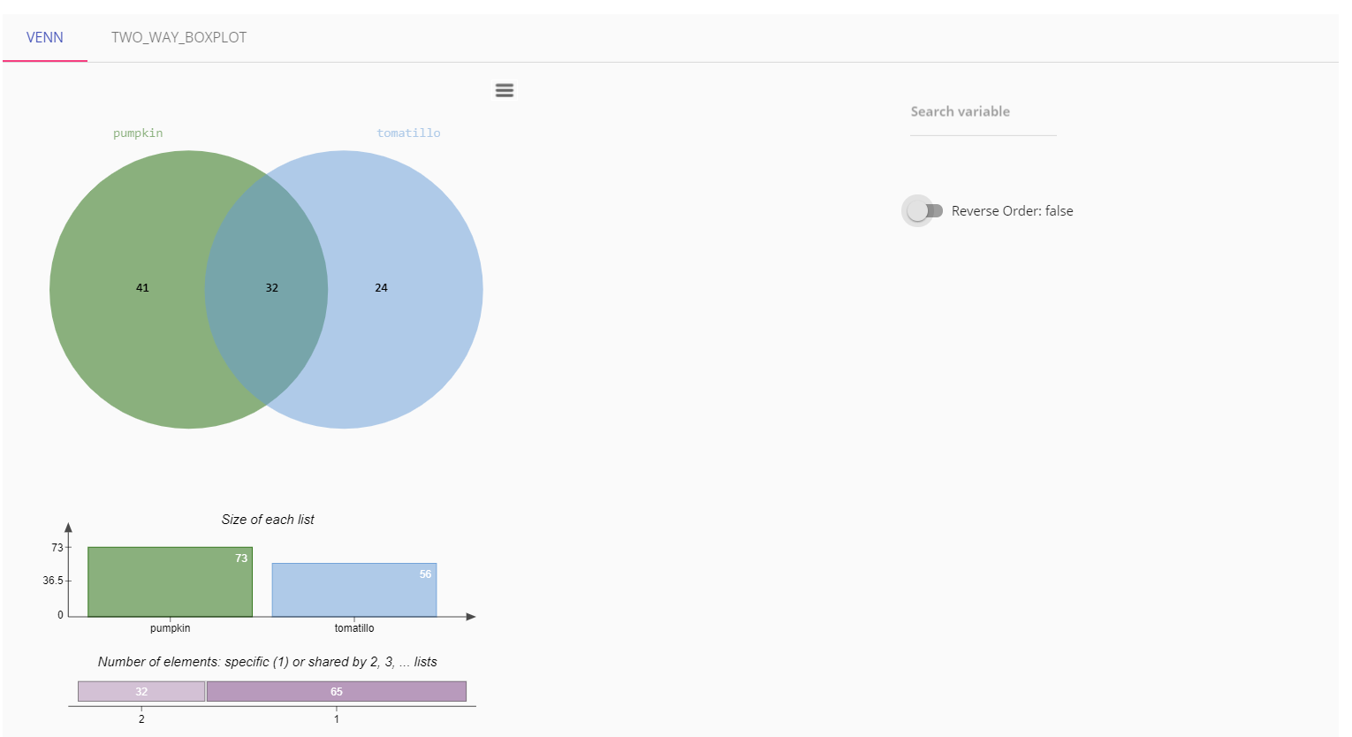
Number of compounds with significant species in each of the levels in treatment
Number of compounds with significant treatment in each of the levels in species
Use compound label to locate compound
Click to view compounds in result table
Number of species significant compounds in each level of treatment
Number of compounds shared by 1,2,3,4,…circles.
Venn diagram to visualize the simple main effect, e.g. the pumpkin vs tomatillo at each level of treatment.
3

Slide 5
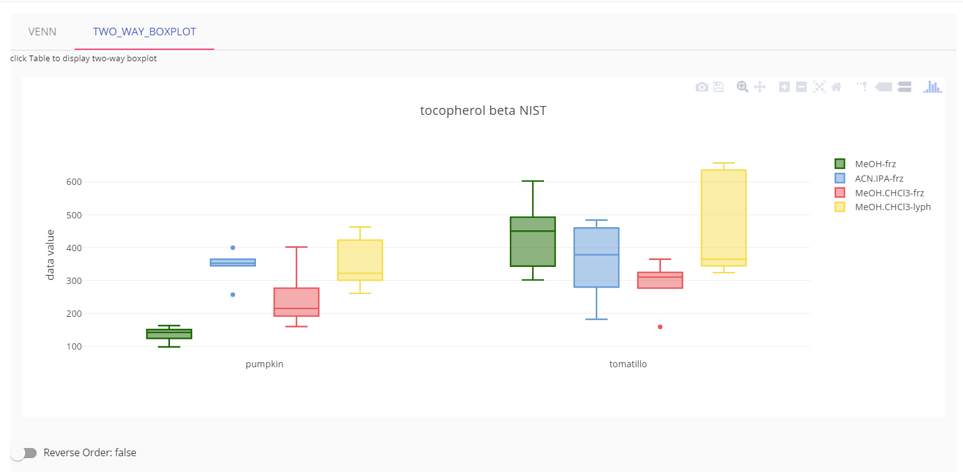
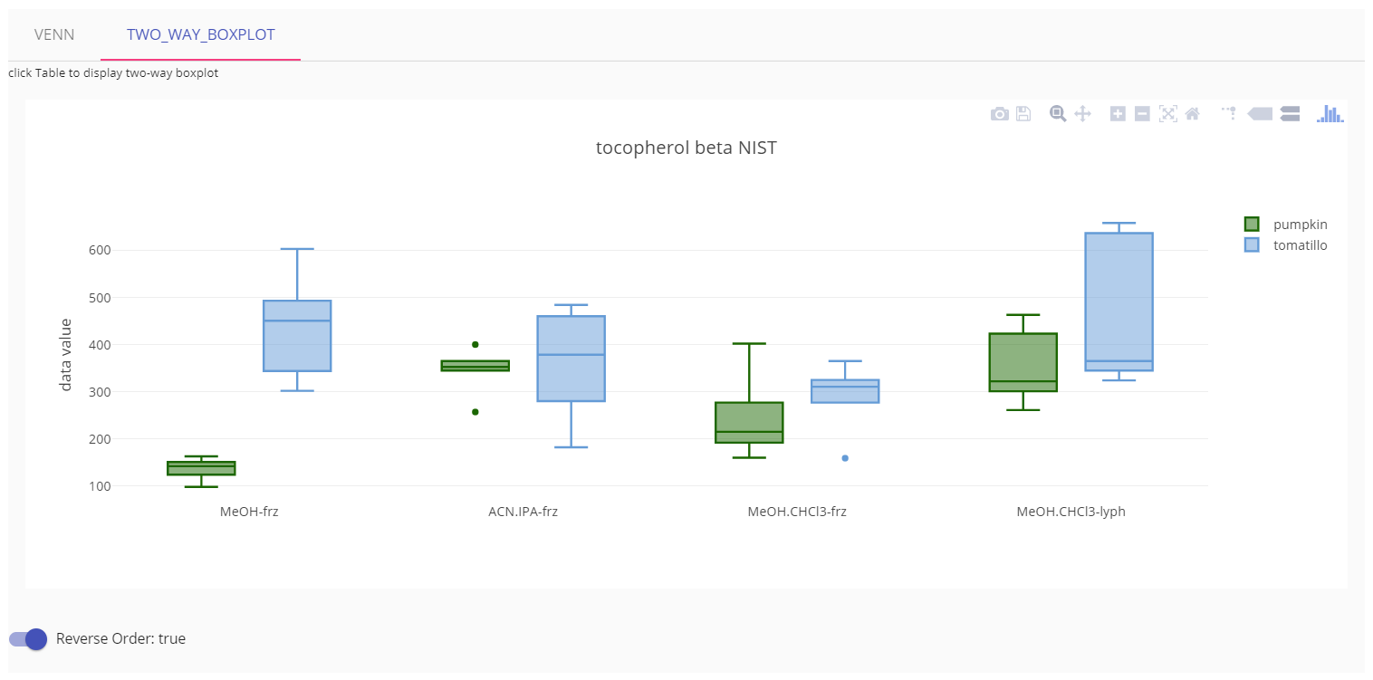
Visualizing each compound using boxplot
Click result table row to visualize each compound by boxplot.
Scatters next to boxplots are the sample values.
Boxplots for all the compounds can be generated/saved in Visualization->Boxplot.
4

